Slide 1



Dhiraj Pakhrin and Ayush Uprety
Assessing the Impact of Air Pollution on Asthma Prevalence in
Los Angeles

Slide 2


Introduction
Cities and big metropolitan areas report frequently poor quality of air as a result of various human activities.
This has increased the threats of respiratory disease in human beings.
With the rise in PM2.5, has impacted hospital admissions of people experiencing asthma.

Slide 3
Introduction(Motivation)
Extract the relationship between air pollution and Asthma, especially focusing on Los Angeles.
The result obtained from this analysis can be valuable insights for public health organizations for policy making.

Slide 4


Introduction (Problem Description)
Find what are the major causes of air pollution in LA.
Determine how the rise in air degradation has impacted human health causing Asthma in Los Angeles.
Display the correlation between air pollution and Asthma.

Slide 5
Introduction (Solution)
Past data regarding the Air Quality and hospitalization of patients are collected from various sources to see the trend of these parameters.
These data are analyzed and represented using various diagrams to provide a visual representation.

Slide 6
Introduction(Findings)
Impact of PM 2.5 air quality to increase air pollution in LA with some outliers.
Trends in air quality over the years do determine temporary or long-term patterns.
Major correlation between the air quality and Asthma

Slide 7
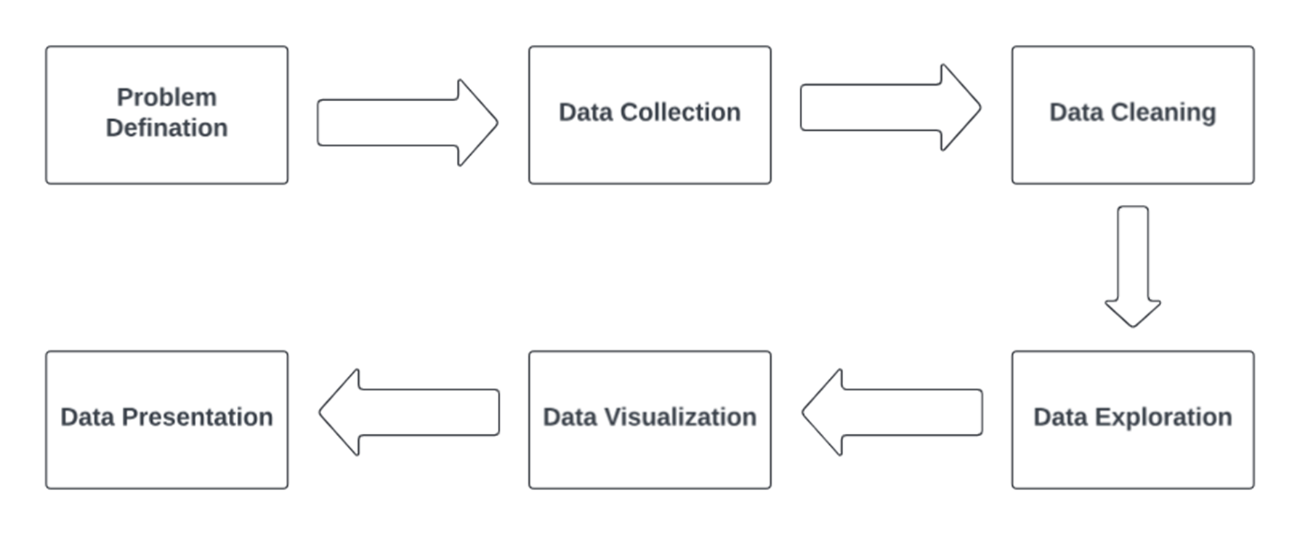
Detail of the Solution

Slide 8
Problem Definition
Problem Definition
Public Health Concern
•Impact on Community
1
3
Does the air pollution in LA cause asthma cases (respiratory disease) to increase?
Possibility of Innovation
•Policy Making
2
4

Slide 9
Data Collection
U.S. Environmental Protection Agency
This dataset contains the Air Quality Index value of Los Angeles for a specific year.
HeathData.gov
This dataset contains the number of patients hospitalized in a specific county for a specific year.

Slide 10
Data Cleaning
•Missing values are handled by dropping the rows.
•Duplicate data are dropped.
•Unnecessary columns are removed
•Renaming the columns to maintain clarity of data.
•Transforming the data into a suitable datatype.
•Cleaned data are saved in the data frame.

Slide 11



Data Exploration
Statistical Analysis
understand the characteristics of data
Correlation Analysis
identify any statistically significant relationships between the studied variables
Visual Data Exploration
visualize the frequency distribution of AQI value and track the trends overtime

Slide 12
Data Visualization and Presentation
Bar-graph
Histogram
Time Series
Scatter Plot
Heatmap

Slide 13
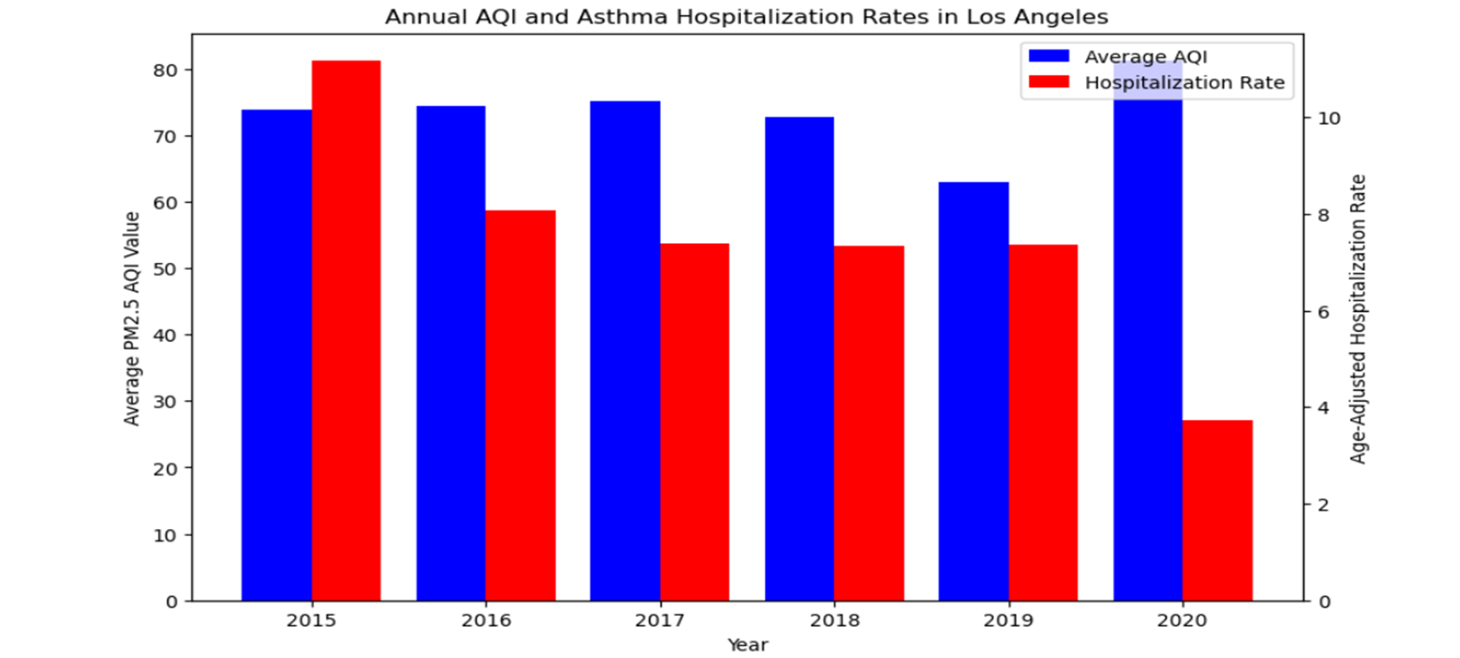
Bar Graph

Slide 14
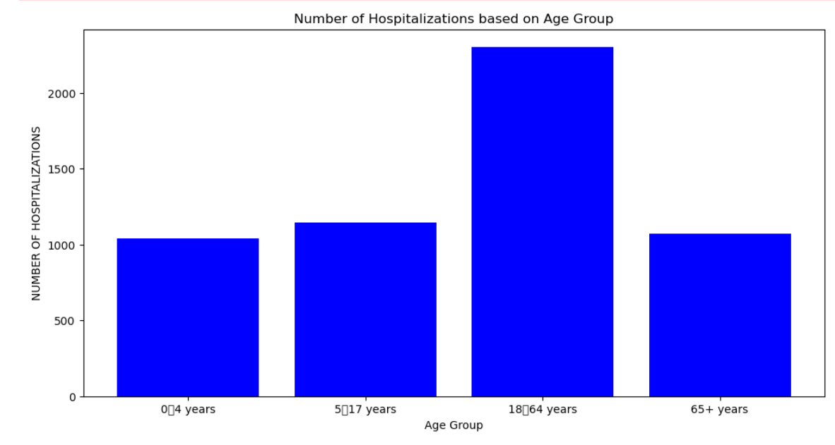
Bar Graph

Slide 15
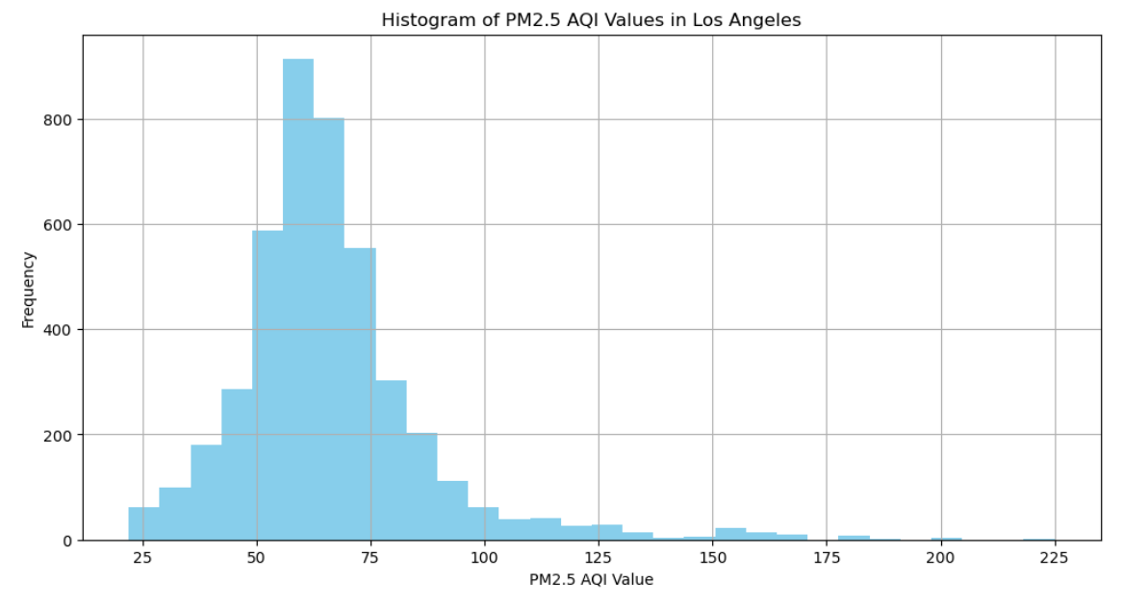
Histogram

Slide 16
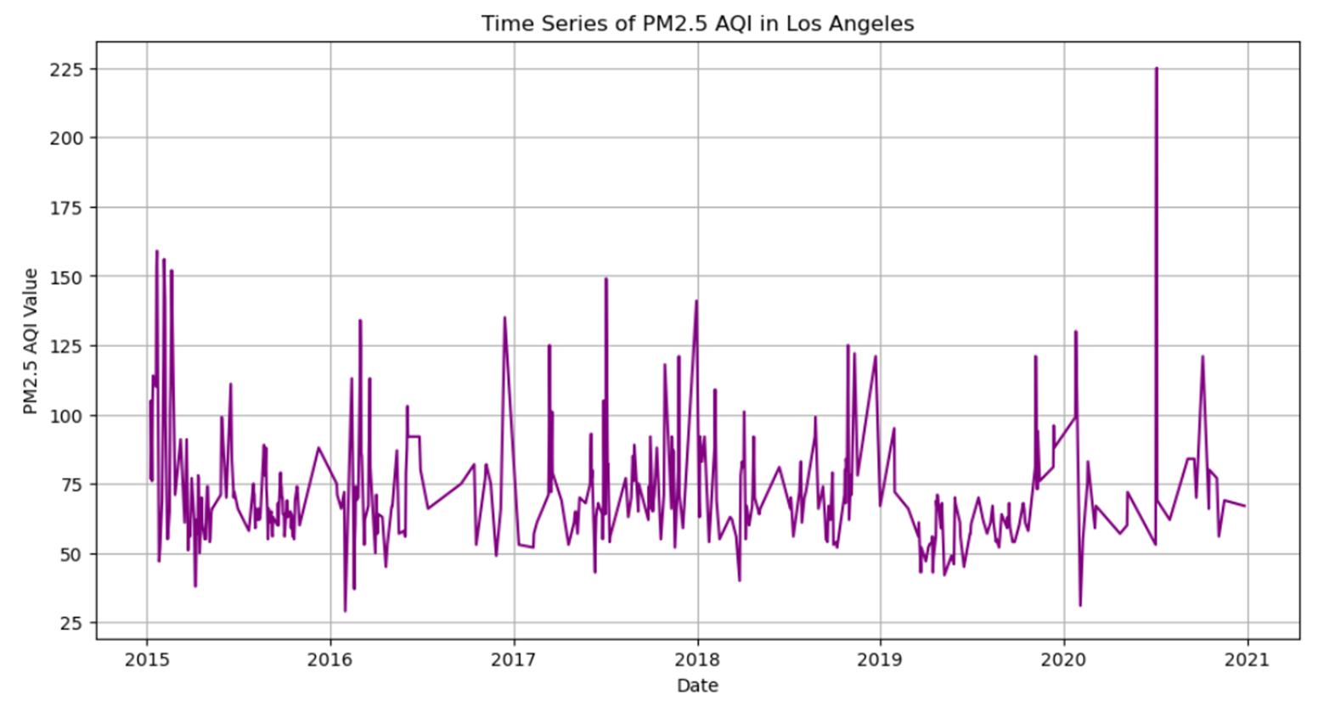
Time Series

Slide 17
Experimental Results demonstrating/proving(Test Performed)
Correlation Analysis: Determine some statistical link between air pollution and asthma.
Regression Analysis: Determine the impact on our Asthma (dependent variable) when there is a change in air pollution(Independent Variable)
Trend Analysis: Determines the movement of air pollution with certain seasonal patterns.

Slide 18
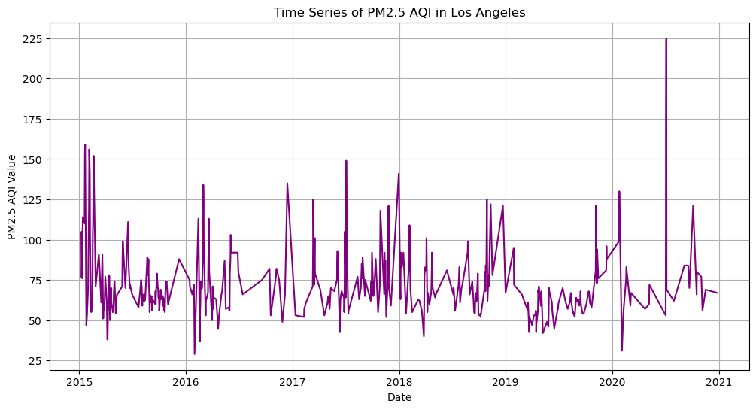
Experimental Results demonstrating/proving(Key Result)
From Trend Analysis, we determined the fluctuation of the air quality index and the hospitalized rate of patients due to asthma.
4

Slide 19
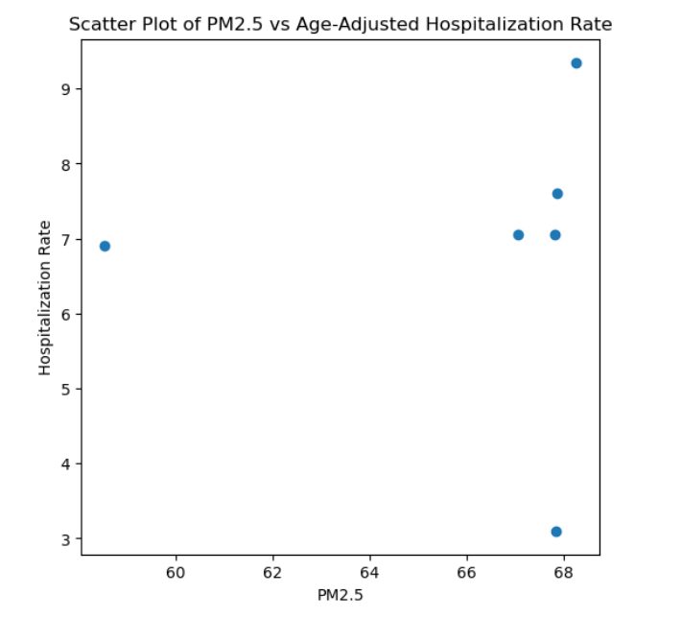
Experimental Results demonstrating/proving(Key Result)
From the given scattered plot, unlike the outlier when the hospitalization rate is 3 when the pm 2.5 is 68, the data shows direct relationship with the given variables.

Slide 20
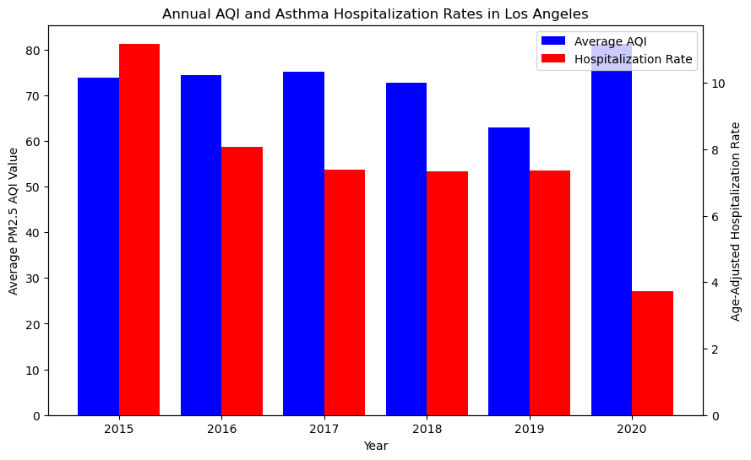
Experimental Results demonstrating/proving(Key Result)
Although our hypothesis states a direct proportion between our variables, the regression analysis showed the exceptions for some particulr years.
Although our hypothesis states a direct proportion between our variables, the regression analysis showed the exceptions for some particular years.
4

Slide 21
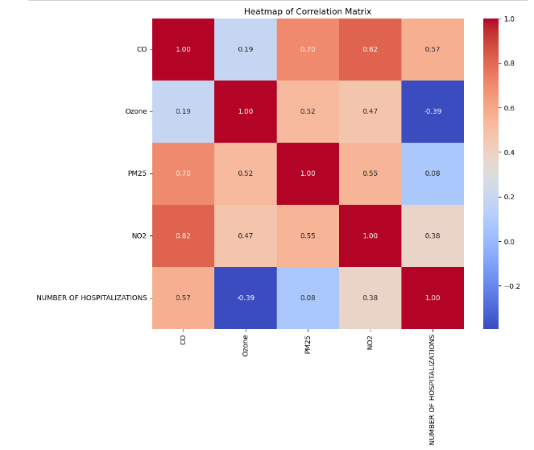
Experimental Results demonstrating/proving(Key Result)
From the correlation analysis, a positive correlation was found between our variables although there are some exceptional cases.
•Impact on Community
3
•Policy Making
4

Slide 22
Conclusions
In general, the analysis also indicates a high level of PM 2.5 at the beginning of every year.
Although there are some exceptions, this survey is proof of a positive correlation between air pollution and respiratory health
Los Angeles' PM2.5 levels rise, raising asthma hospitalization rates.

Slide 23
Challenges
The quality of data and its availability was a bit less which made the process of data analysis challenging.
Considering all the other factors of air pollution requires a lot of time and effort. Our analysis only relies on the PM 2.5 air quality index for most of our analysis.

Slide 24
Lesson Learned and Future direction
This analysis emphasizes the importance of air quality to improve the cases of respiratory diseases like Asthma.
Proper policy and community awareness regarding air quality issues can be conducted.
Implementation of advanced technology and big data for comprehensive analysis.
Real-time data noise could be devised to notify people living in the area when high-risk days occur.

Slide 25

Thank
You
Thank
You

